Slide 1

Advanced NLP (Word Vector – Bag 2)
NLP
Dr. Sajarwo Anggai, S.ST., M.T. NIDN : 0421108703

Slide 2
NLP Pipeline
Text Preprocessing
Feature Extraction
Modeling
Post-Processing
Deployment
Segmentation/ Tokenization
Normalization/ Lowercasing
Stopword Removal
Punctuation Removal
Stemming/ Lemmatization
Depedency parsing
Part-of-Speech Tagging
Bag of Words (BoW)
TF-IDF
Word Embeddings
Machine Learning
Deep Learning
Prediction
Evaluation
Fine-Tuning
Production
Monitoring and Updating

Slide 3
GloVe
Glove is based on matrix factorization technique on word context matrix. It first constructs a large matrix of (words x context) co-occurrence information ie. for each word, you count how frequently we see those word in some context in a large corpus.
Glove is a word vector representation method where training is performed on aggregated global word-word co-occurrence statistics from the corpus. This means that like word2vec it uses context to understand and create the word representations. The research paper describing the method is called GloVe: Global Vectors for Word Representation and is well worth a read as it describes some of the drawbacks of LSA and Word2Vec before describing their own method.
https://medium.com/@mervebdurna/advanced-word-embeddings-word2vec-glove-and-fasttext-26e546ffedbd

Slide 4
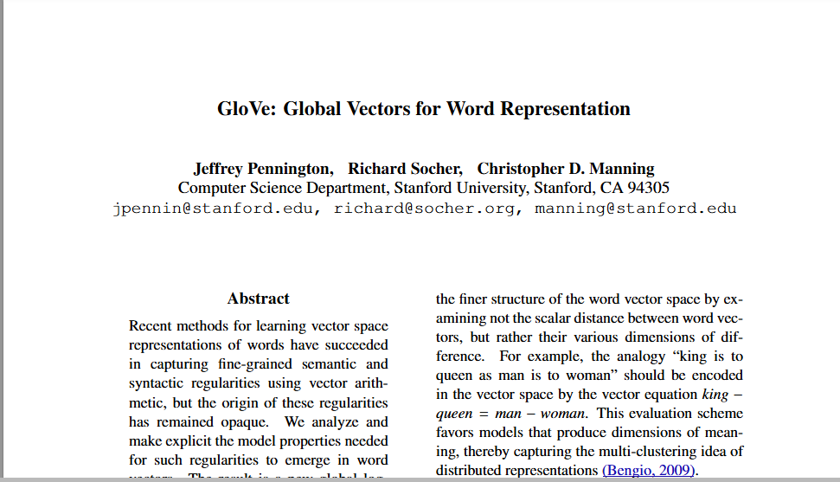
GloVe
https://nlp.stanford.edu/projects/glove/
https://nlp.stanford.edu/pubs/glove.pdf

Slide 5
GloVe
The key to GloVe’s effectiveness lies in the construction of a word-context matrix and the subsequent factorization process.
1. Word-Context Matrix Formation:
The first step in GloVe’s mechanics involves creating a word-context matrix. This matrix is designed to represent the likelihood of a given word appearing near another across the entire corpus. Each cell in the matrix holds the co-occurrence count of how often words appear together in a certain context window.
https://medium.com/@mervebdurna/advanced-word-embeddings-word2vec-glove-and-fasttext-26e546ffedbd

Slide 6
GloVe
2. Factorization for Word Vectors:
With the word-context matrix in place, GloVe turns to matrix factorization. The objective here is to decompose this high-dimensional matrix into two smaller matrices — one representing words and the other contexts. Let’s denote these as W for words and C for contexts. The ideal scenario is when the dot product of W and CT (transpose of C) approximates the original matrix:
X≈W⋅CT
Through iterative optimization, GloVe adjusts W and C to minimize the difference between X and W⋅CT. This process yields refined vector representations for each word, capturing the nuances of their co-occurrence patterns.
https://medium.com/@mervebdurna/advanced-word-embeddings-word2vec-glove-and-fasttext-26e546ffedbd

Slide 7
GloVe
3. Vector Representations:
Once trained, GloVe provides each word with a dense vector that captures not just local context but global word usage patterns. These vectors encode semantic and syntactic information, revealing similarities and differences between words based on their overall usage in the corpus.
https://medium.com/@mervebdurna/advanced-word-embeddings-word2vec-glove-and-fasttext-26e546ffedbd

Slide 8
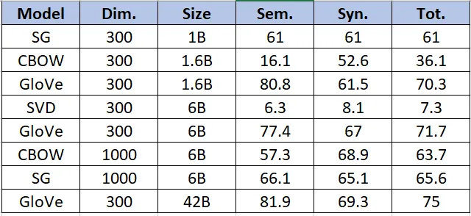
GloVe
Table 2: Semantic, Syntactic and Total model accuracy on word analogy task (Source- GloVe research paper)
https://towardsdatascience.com/glove-research-paper-explained-4f5b78b68f89

Slide 9
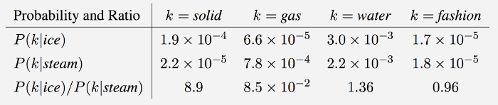
GloVe
Model Overview
GloVe is essentially a log-bilinear model with a weighted least-squares objective. The main intuition underlying the model is the simple observation that ratios of word-word co-occurrence probabilities have the potential for encoding some form of meaning. For example, consider the co-occurrence probabilities for target words ice and steam with various probe words from the vocabulary. Here are some actual probabilities from a 6 billion word corpus:
https://nlp.stanford.edu/projects/glove/

Slide 10
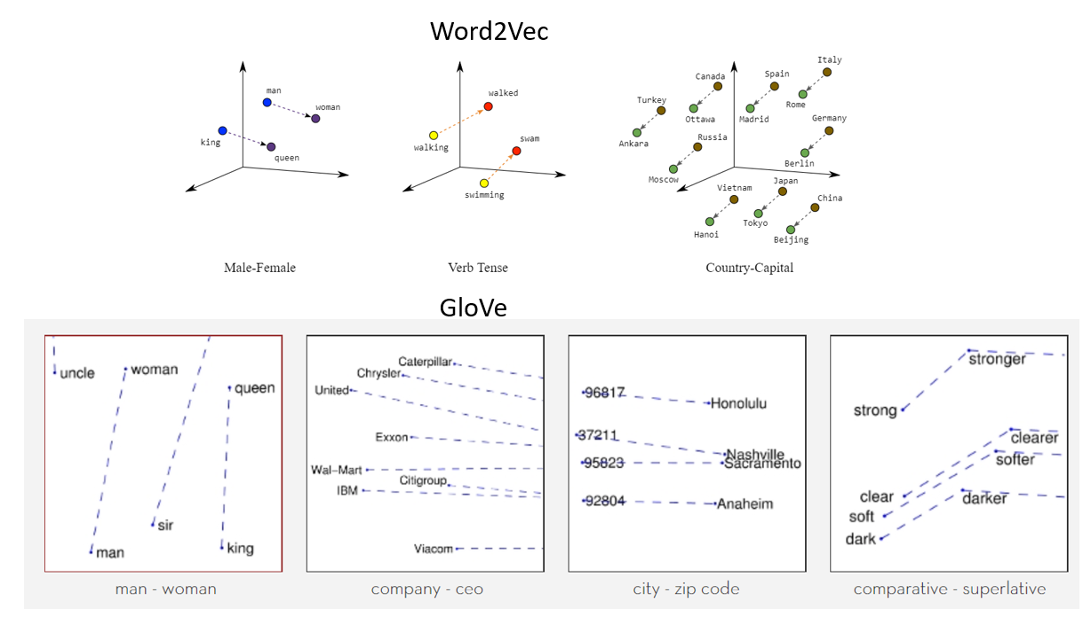
Visualisasi antara Word2vec - GloVe
https://www.analyticsvidhya.com/blog/2021/06/practical-guide-to-word-embedding-system/#h-glove

Slide 11
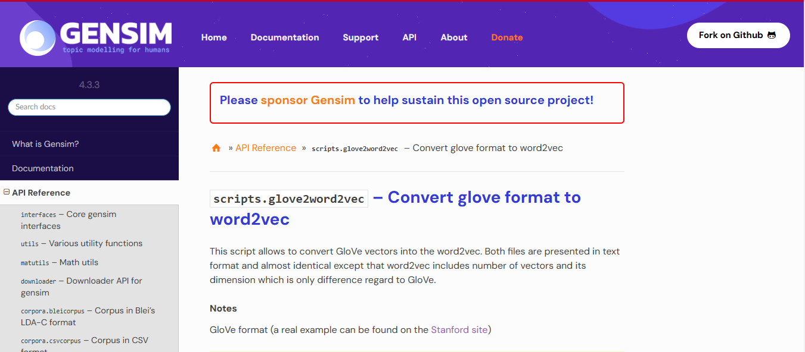
Gensim Library for GloVe
https://radimrehurek.com/gensim/scripts/glove2word2vec.html

Slide 12
1. Import Library dan data yang akan digunakan
import gensim
import numpy as np
from gensim.scripts.glove2word2vec import glove2word2vec
2. Path ke File GloVe setelah diunduh
glove_file = 'C:/Users/Asus/python/glove.6B.300d.txt'

Slide 13
2. Membuat Model GloVe
word2vec_output_file = 'glove.6B.300d.word2vec.txt'
glove2word2vec(glove_file, word2vec_output_file)
model = gensim.models.KeyedVectors.load_word2vec_format(word2vec_output_file, binary=False)
vector = model['computer']
print(vector)

Slide 14
2. Membuat Model Word2Vec
Penjelasan Parameter :
sentences: Data input untuk melatih model, berupa list of tokenized sentences.
vector_size: Ukuran atau dimensi dari embedding vektor. Misalnya, jika vector_size=100, setiap kata akan direpresentasikan oleh vektor berdimensi 100.
window: Jumlah kata di sebelah kiri dan kanan kata target yang akan dilihat sebagai konteksnya. Misalnya, jika window=5, maka kata target akan dilihat bersama 5 kata di sekitarnya.
min_count: Minimum jumlah kemunculan kata agar dimasukkan ke dalam vocabulary. Kata yang muncul lebih sedikit dari ini akan diabaikan.
workers: Jumlah thread untuk mempercepat pelatihan.
sg: Menentukan algoritma yang digunakan. sg=0 untuk Continuous Bag of Words (CBOW) dan sg=1 untuk Skip-gram.
epochs: Jumlah iterasi pelatihan pada data.

Slide 15
Ref Tambahan
https://web.stanford.edu/class/archive/cs/cs224n/cs224n.1214/materials/Gensim%20word%20vector%20visualization.html
https://www.analyticsvidhya.com/blog/2021/06/practical-guide-to-word-embedding-system/#h-glove
https://nlp.stanford.edu/projects/glove/
https://medium.com/analytics-vidhya/word-embeddings-in-nlp-word2vec-glove-fasttext-24d4d4286a73
https://medium.com/@mervebdurna/advanced-word-embeddings-word2vec-glove-and-fasttext-26e546ffedbd
https://towardsdatascience.com/glove-research-paper-explained-4f5b78b68f89
https://medium.com/@mervebdurna/advanced-word-embeddings-word2vec-glove-and-fasttext-26e546ffedbd

Slide 16
FastText
FastText is an advanced word embedding technique developed by Facebook AI Research (FAIR) that extends the Word2Vec model. Unlike Word2Vec, FastText not only considers whole words but also incorporates subword information — parts of words like n-grams. This approach enables the handling of morphologically rich languages and captures information about word structure more effectively.
As its name suggests its fast and efficient method to perform same task and because of the nature of its training method, it ends up learning morphological details as well.
https://medium.com/analytics-vidhya/word-embeddings-in-nlp-word2vec-glove-fasttext-24d4d4286a73

Slide 17
FastText
FastText is unique because it can derive word vectors for unknown words or out of vocabulary words — this is because by taking morphological characteristics of words into account, it can create the word vector for an unknown word. Since morphology refers to the structure or syntax of the words, FastText tends to perform better for such task, word2vec perform better for semantic task.
FastText works well with rare words. So even if a word wasn’t seen during training, it can be broken down into n-grams to get its embeddings.
https://medium.com/analytics-vidhya/word-embeddings-in-nlp-word2vec-glove-fasttext-24d4d4286a73

Slide 18
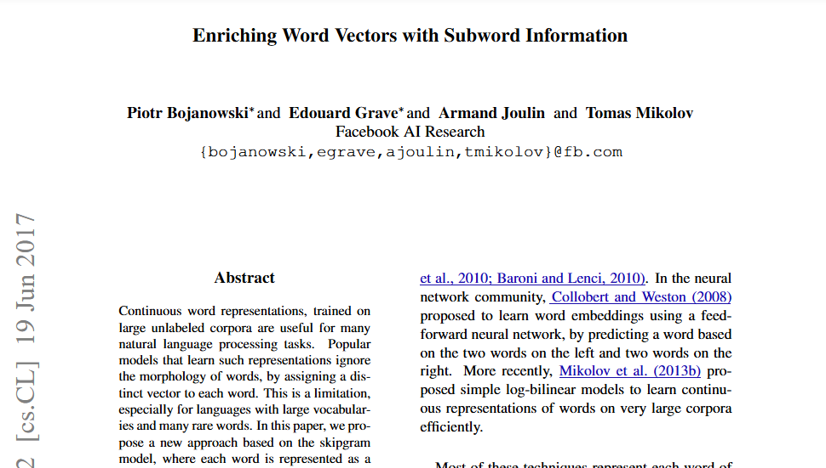
FastText
https://fasttext.cc/docs/en/references.html
https://arxiv.org/pdf/1607.04606

Slide 19
FastText
FastText model is explained
1. Subword Information:
FastText represents each word as a bag of character n-grams in addition to the whole word itself. This means that the word “apple” is represented by the word itself and its constituent n-grams like “ap”, “pp”, “pl”, “le”, etc. This approach helps capture the meanings of shorter words and affords a better understanding of suffixes and prefixes.
https://medium.com/@mervebdurna/advanced-word-embeddings-word2vec-glove-and-fasttext-26e546ffedbd

Slide 20
FastText
2. Model Training:
Similar to Word2Vec, FastText can use either the CBOW or Skip-gram architecture. However, it incorporates the subword information during training. The neural network in FastText is trained to predict words (in CBOW) or context (in Skip-gram) not just based on the target words but also based on these n-grams.
https://medium.com/@mervebdurna/advanced-word-embeddings-word2vec-glove-and-fasttext-26e546ffedbd

Slide 21
GloVe
3. Handling Rare and Unknown Words:
A significant advantage of FastText is its ability to generate better word representations for rare words or even words not seen during training. By breaking down words into n-grams, FastText can construct meaningful representations for these words based on their subword units.
https://medium.com/@mervebdurna/advanced-word-embeddings-word2vec-glove-and-fasttext-26e546ffedbd

Slide 22
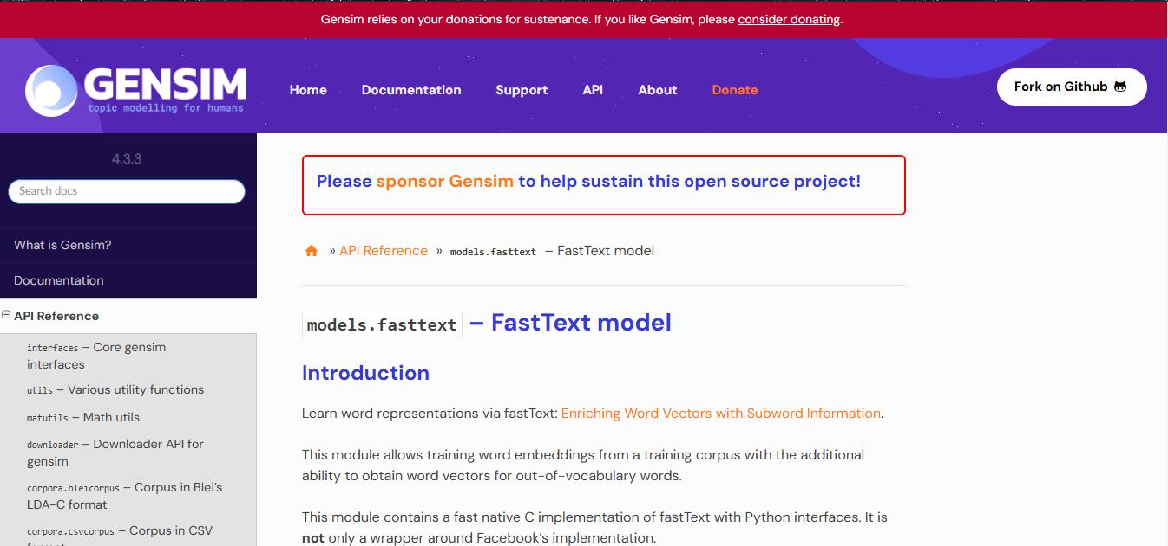
Gensim Library for FastText
https://radimrehurek.com/gensim/models/fasttext.html

Slide 23
1. Import Library dan data yang akan digunakan
from gensim.models import FastText, KeyedVectors
from gensim.test.utils import datapath
import os

Slide 24
2. Membuat Model FastText
fasttext_model = FastText(
sentences=bahasa, # Dataset
vector_size=100, # Dimensi vektor kata
window=5, # Ukuran jendela konteks
min_count=1, # Frekuensi minimum kemunculan kata
sg=1, # 1 untuk skip-gram; 0 untuk CBOW
negative=10, # Jumlah kata negatif untuk sampling negatif
epochs=5, # Jumlah iterasi untuk pelatihan
min_n=3, # Panjang minimum n-gram
max_n=6, # Panjang maksimum n-gram
bucket=2000000, # Jumlah hash buckets untuk n-gram
alpha=0.025 # Laju pembelajaran awal
)

Slide 25
2. Membuat Model FastText
Penjelasan Parameter :
sentences: Input teks yang digunakan untuk melatih model.
vector_size: Menentukan jumlah dimensi dari embedding.
window: Ukuran jendela kata yang dipertimbangkan di sekitar kata target.
min_count: Frekuensi minimum kata agar dimasukkan dalam kosakata.
sg: Menentukan algoritma (1 untuk skip-gram, 0 untuk CBOW).
negative: Jumlah sampel negatif untuk pembelajaran (menambah noise untuk meningkatkan generalisasi).
epochs: Jumlah iterasi untuk pelatihan.
min_n dan max_n: Rentang panjang n-gram untuk pembentukan sub-kata.
bucket: Ukuran hash bucket yang memungkinkan penyimpanan n-gram.
alpha: Laju pembelajaran awal; biasanya berkurang saat iterasi bertambah.

Slide 26
3. Implementasi FastText
Mencari embedding kata (bisa juga untuk kata yang belum muncul)
print(fasttext_model.wv['data'])
Mencari kata yang mirip
similar_words = fasttext_model.wv.most_similar('sistem', topn=10)
Menemukan Kata yang Mirip dengan Kata Tertentu / word pairs
word_pairs = [('glass', 'door'), ('bike', 'motor'), ('city', 'cities'), ('white', 'white'), ('how', 'who')]
# Compute similarity for each pair of words
for pair in word_pairs:
similarity = model.similarity(pair[0], pair[1])
print(f"Similarity between '{pair[0]}' and '{pair[1]}' using FastText: {similarity:.3f}")

Slide 27
Tugas
Cari 10 jurnal terkait dengan Word Vector Representation
Buatlah interface untuk menampilkan hasil dari Word Vector Representations

Slide 28

Universitas Pamulang
Prodi Teknik Informatika S-2
Sajarwo Anggai
Dosen – Universitas Pamulang
NIDN : 0421108703
Email : dosen02832@unpam.ac.id
Terima Kasih

